Slide 1
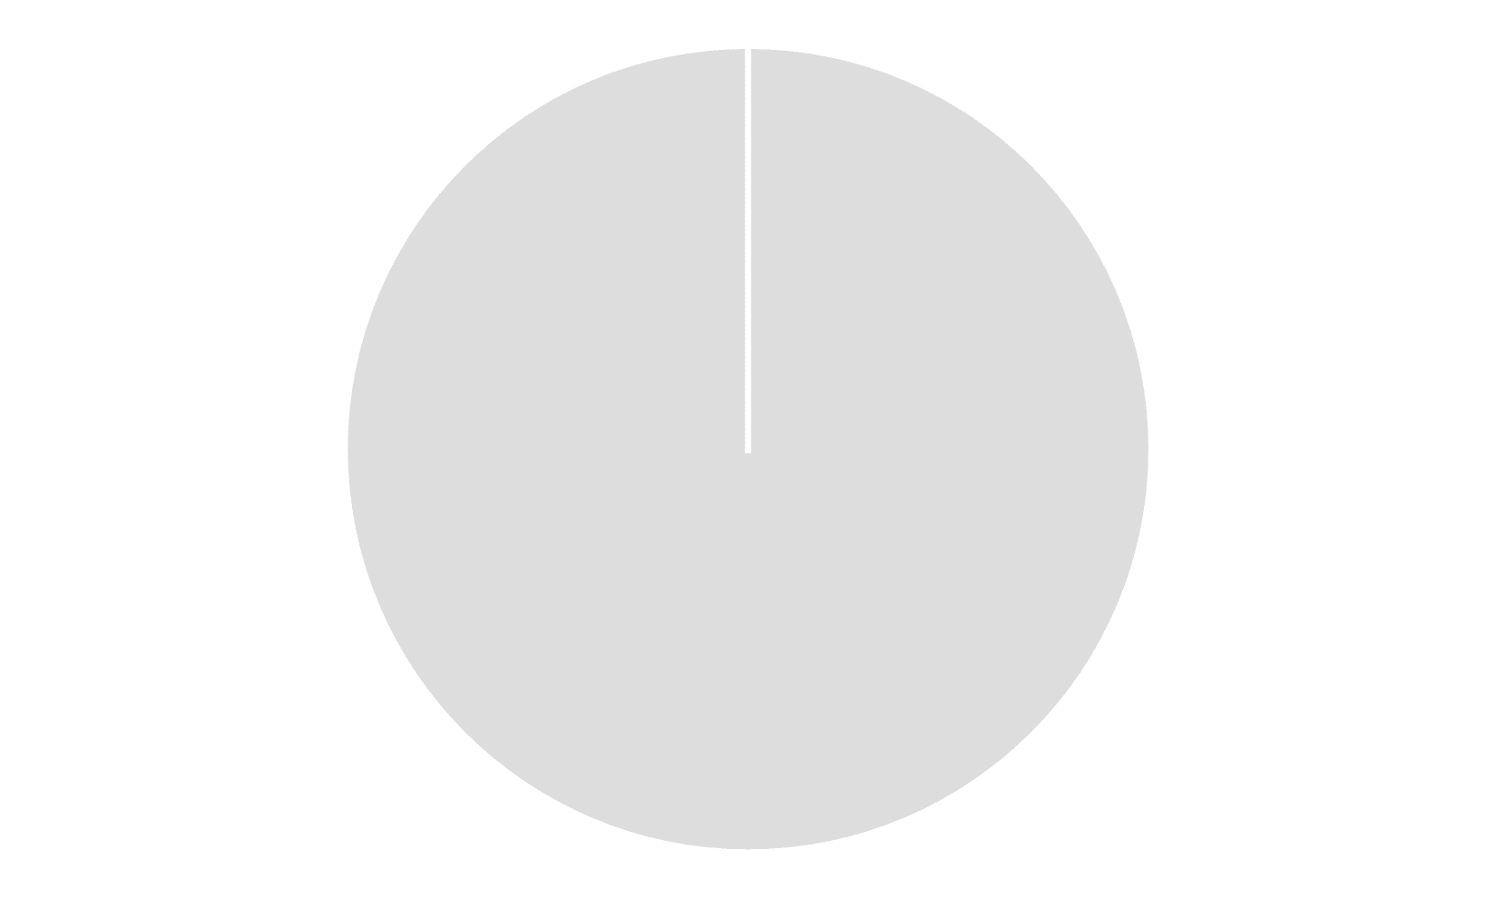
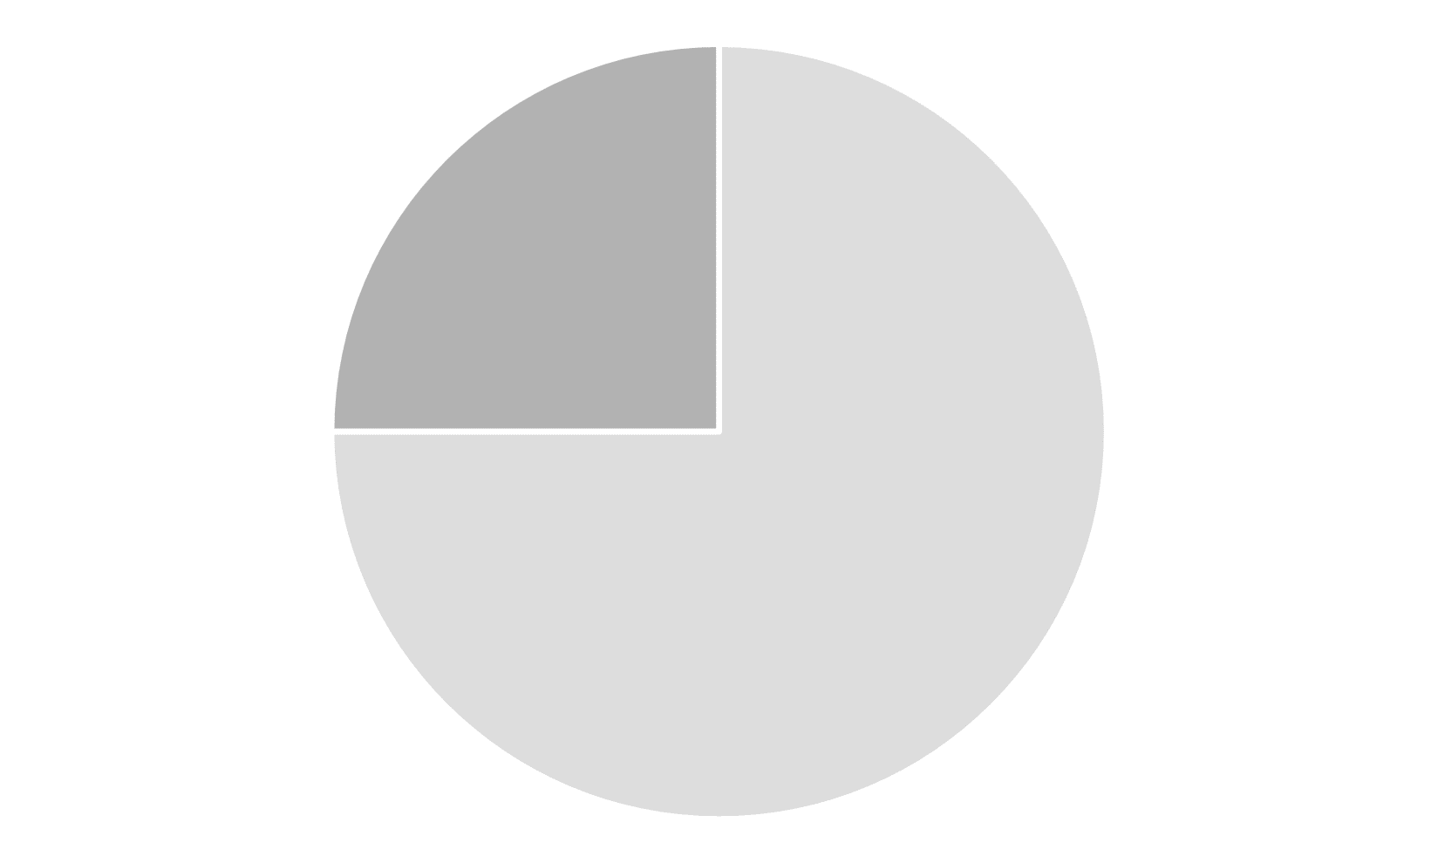
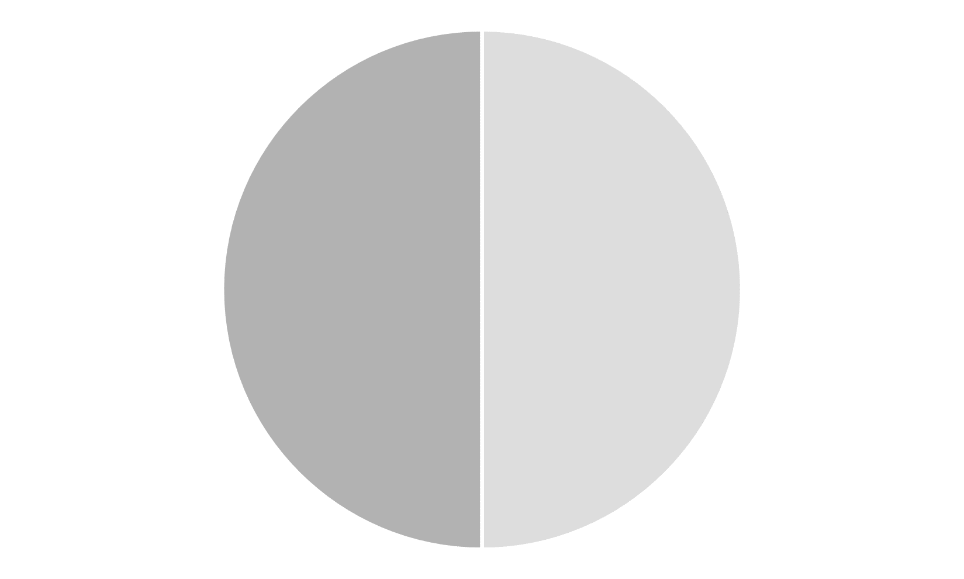
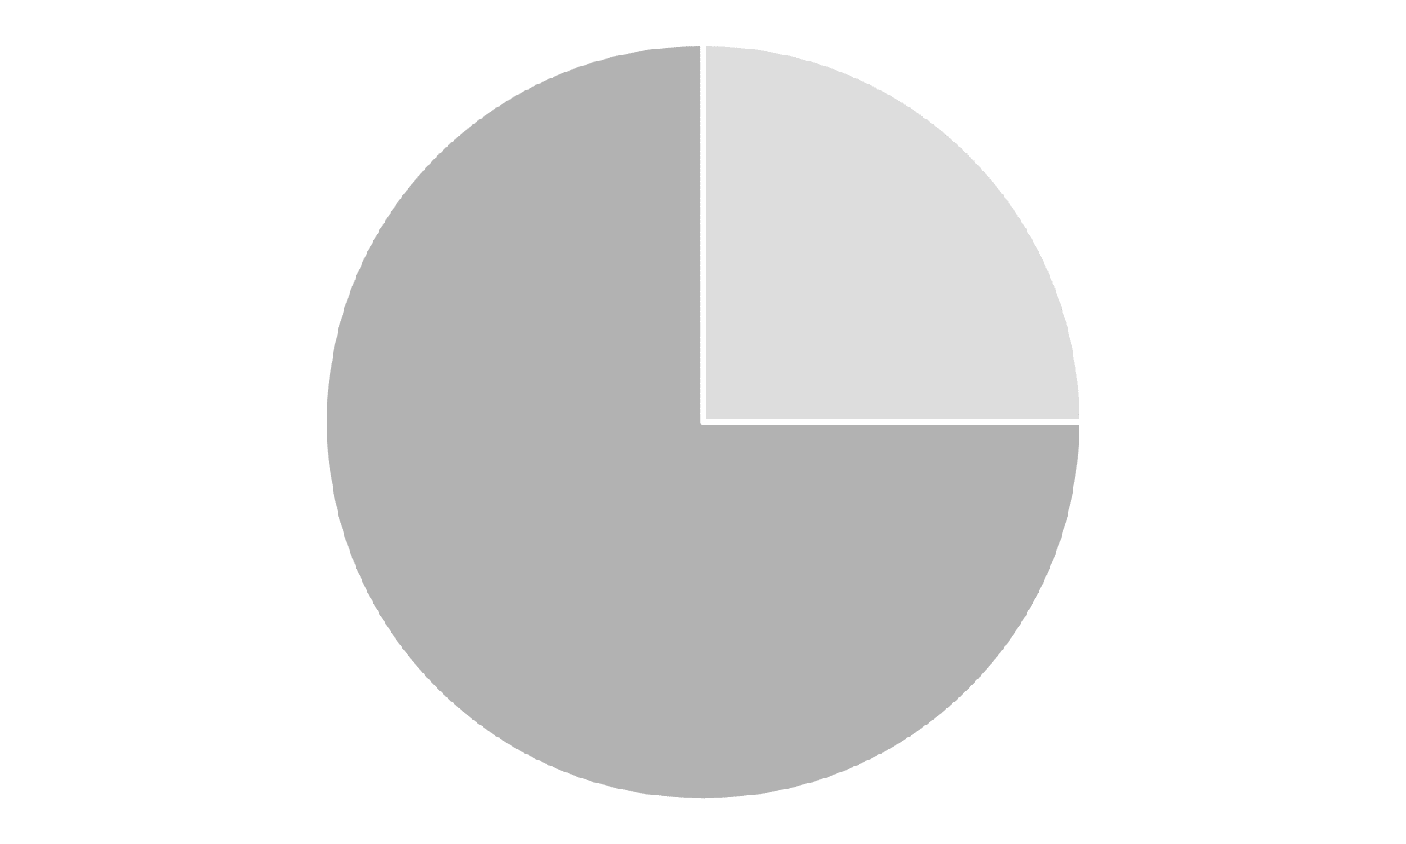
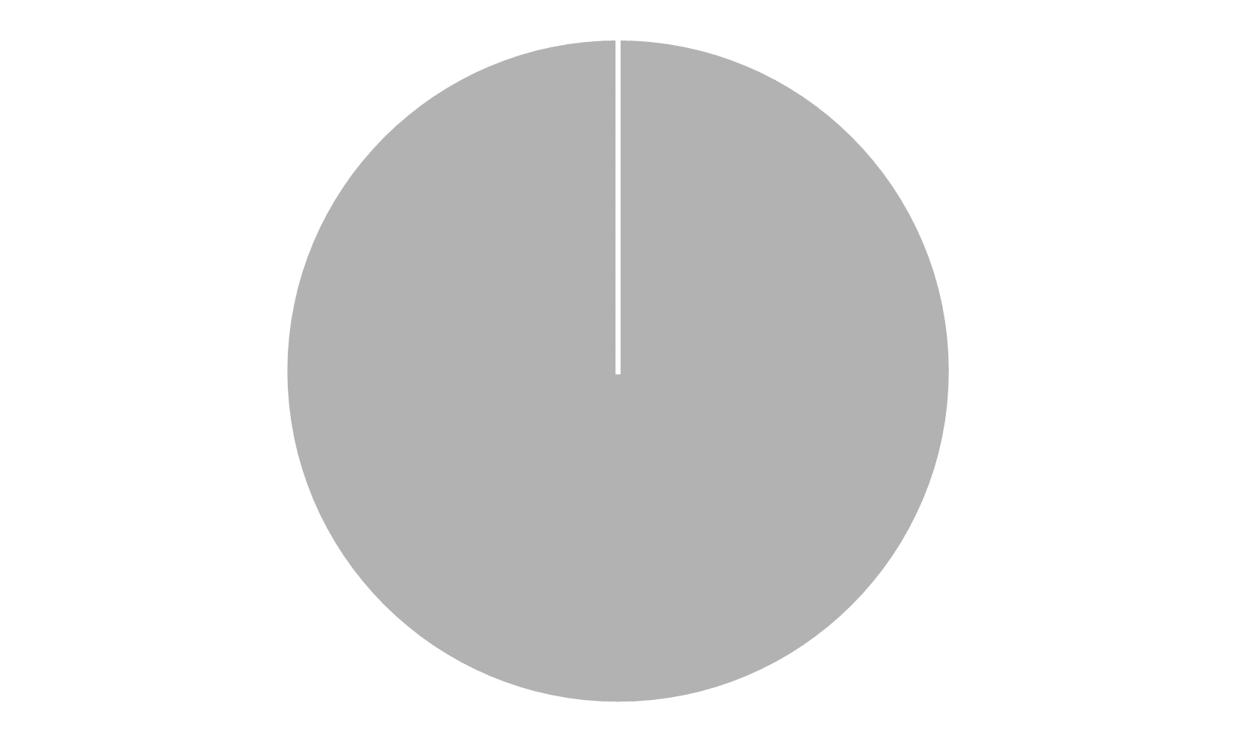
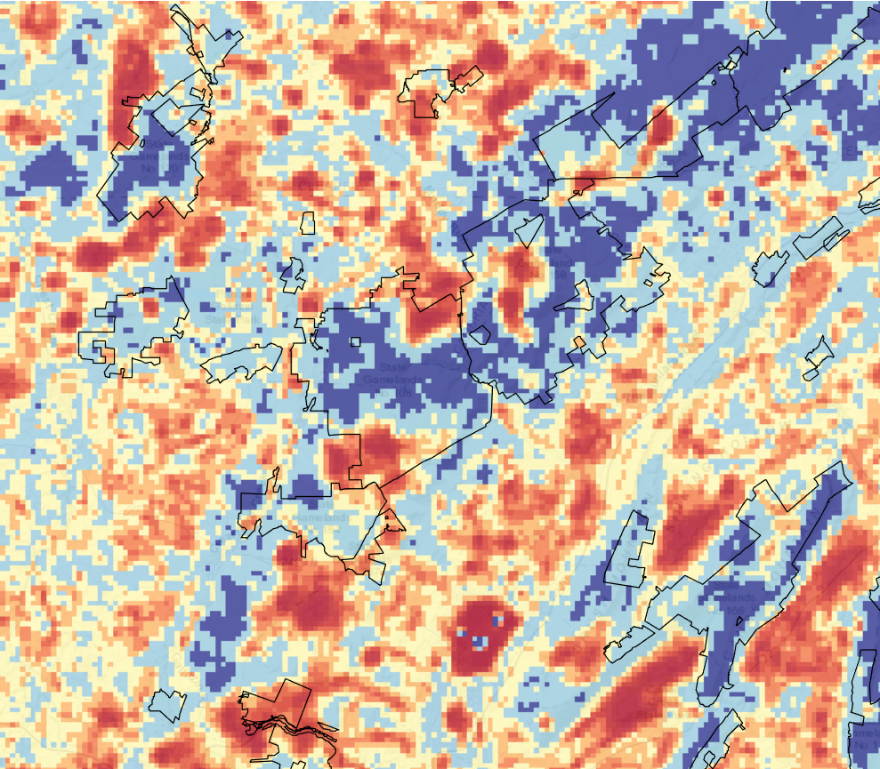
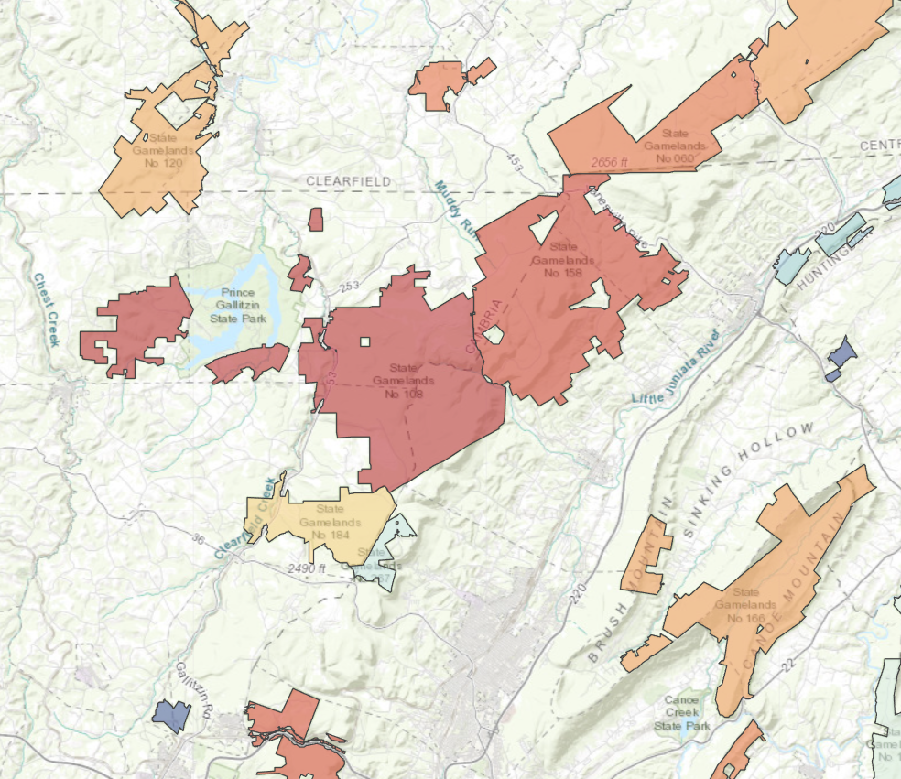
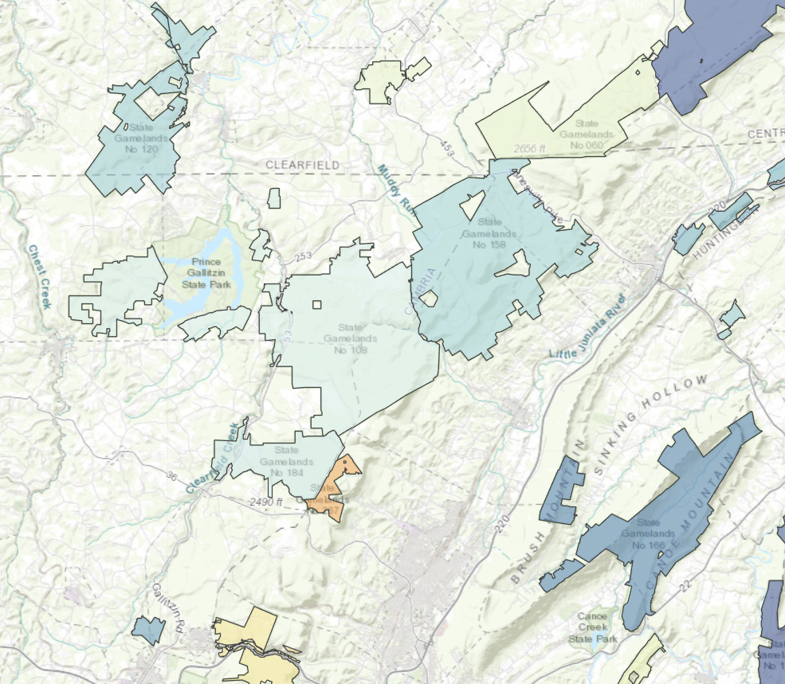
Layers are combined using user-defined weights…
100% breeding, 0% migratory
75% breeding, 25% migratory
50% breeding, 50% migratory
25% breeding, 75% migratory
0% breeding, 100% migratory
….which affect gameland prioritization metrics
Predictive layer
Total habitat
Average habitat

